Slide 1
NE 591: Advanced Reactor Materials
Fall 2021
Dr. Benjamin Beeler

Slide 2
Particle fuels

Slide 3
Macrostructure Changes
The macrostructure of the fuel changes with operation
The high temperature will lead to sintering and restructuring into different zones (as in MOX fuel)
Similar four zone restructuring will occur, but with different zones
1: central void; 2: highly dense fuel similar to a pellet; 3: sintered microstructure with retained porosity; 4: original particle macrostructure
As the structure of the fuel changes, the properties change dramatically with radius and time

Slide 4
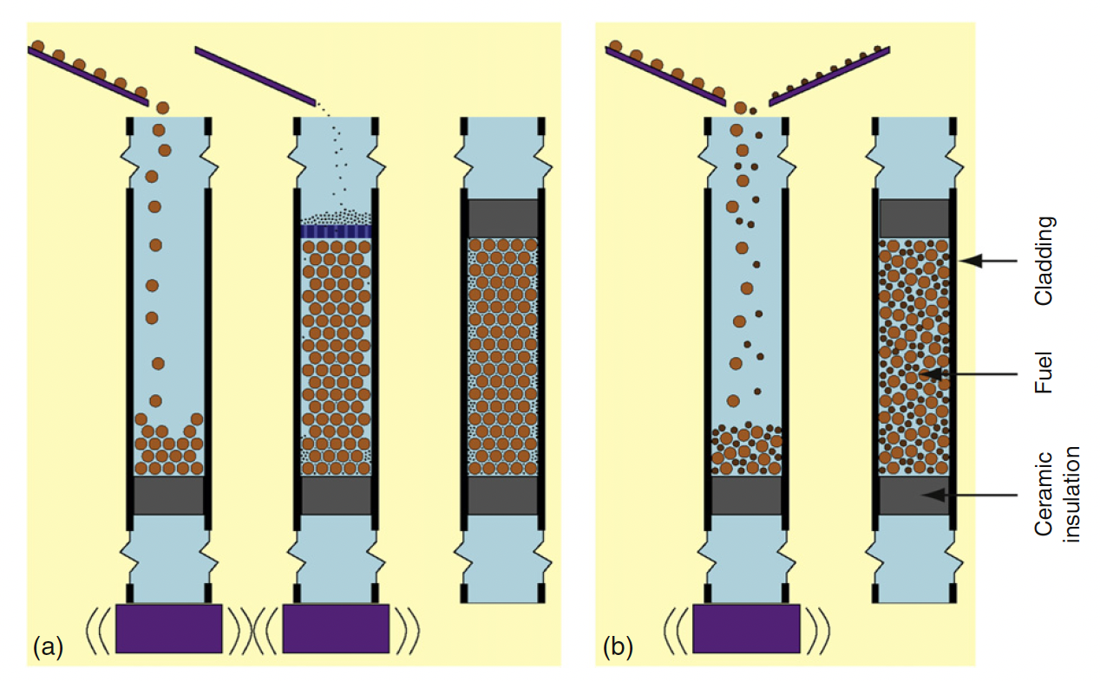
Sphere-Pac Concepts
While the sphere-pac concept is more complex than vipac, it offers additional flexibility
Particle sizes and particle distributions can be included
Spherical particles offer low friction resistance during the filling procedure
Sphere-pac can thus reach up to 90% smear density
Infiltration filling (image a) allows for tailoring of small particles to serve specific purposes, such as an oxygen getter, a low reactivity with cladding, etc.

Slide 5
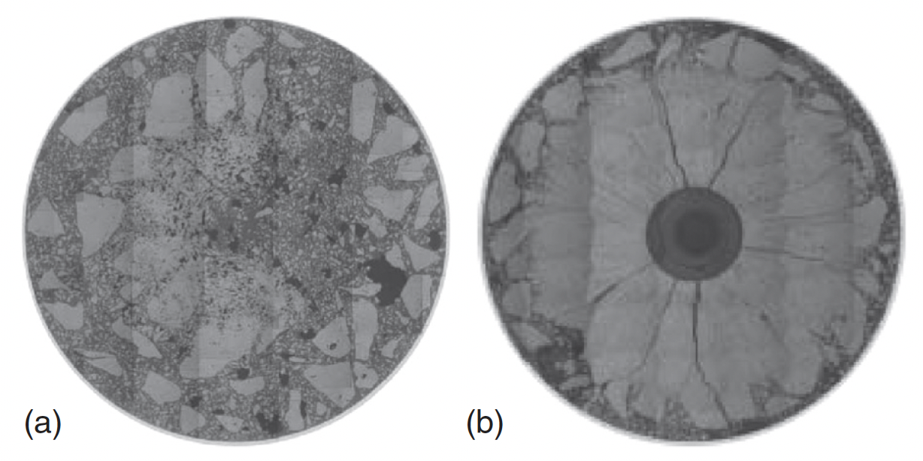
Vipac Irradiations
Japanese irradiations (FUJI Project), with MOX fuel 20% Pu
Vipac fuel after initial sintering test irradiated up to 487 W/cm after 36h
Restructuring test with ramping up to 502 W/cm for 36h and holding at 502 W/cm for 96h

Slide 6
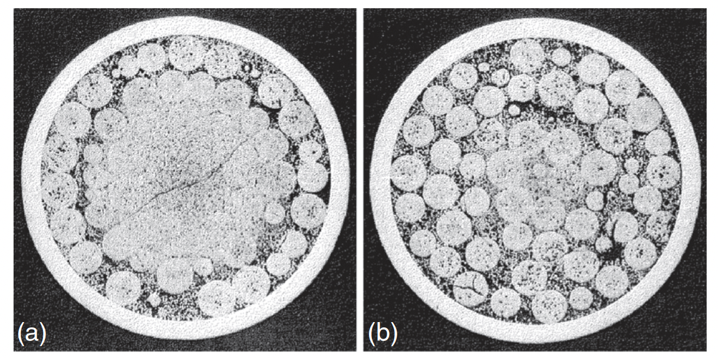
Sphere-Pac Irradiations
Dounreay fast reactor – UPu-C fuels
a) 62 kW/m, 7.3% FIMA, 458C
b) 49 kW/m, 5.7% FIMA, 320C

Slide 7
Overview
Particle fuels are a realistic option for fast reactor systems
Fast reactors allow for efficient burning of actinides
Nominal fast reactor fuel pins are designed for fission gas release, and thus the larger gas release, compared to UO2, is not detrimental
Other fuel bases, other than oxides, can easily be deployed
FCMI is greatly reduced due to the inherent space allowing for swelling of the particles
LWR application is limited

Slide 8
waste glasses

Slide 9
Waste Forms
Fission products (FPs) and minor actinides (MAs) produced during fuel irradiation in the reactor only represent about 5% of the weight of used nuclear fuel, but about 98% of its radioactivity
When fuel is reprocessed, the FPs and MAs end up in concentrated solutions (High Level Waste – HLW) temporarily stored in tanks
Long term (>100 year) storage requires a different path, with initial targets on glass or glass-ceramics to immobilize FPs
The first attempts at the CEA in 1957 targeted crystals of mica-phlogopite: M2Mg6(AlSi3)2O20F4
Twenty years later, borosilicate glass had appeared as the standard choice for the HLW matrix

Slide 11
Questions?

